Slide 1
Introduction to IPV4, TCP and UDP

Slide 2
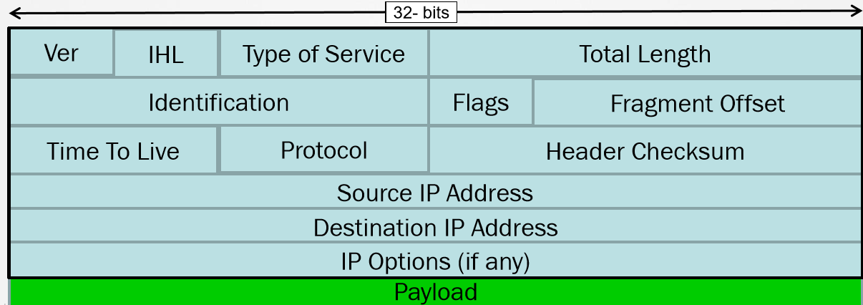
Introduction to IPv4
Internet Protocol version 4
Resides at OSI Layer-3 (Network Layer)
Connectionless(does not verify if the destination exists)
It is a routed protocol

Slide 3
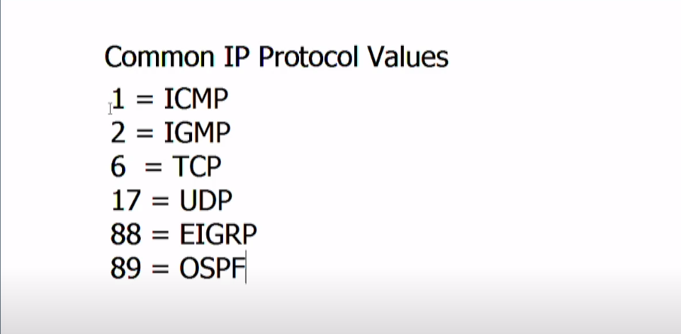
Common IP protocol values

Slide 4
Introduction to IPV4
32-bit addressing system
Logical address for a network defined by IANA
IPv4 addresses are comprised of 4 octets
Dotted decimal notation is used to segment the octet

Slide 5
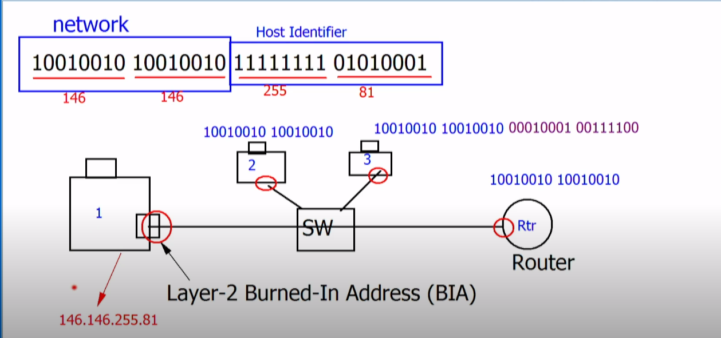
Introduction to IPV4

Slide 6
Communication Types
Unicast
• One-to-one communication
Multicast
• One-to-many communication
Broadcast
• One-to-all communication

Slide 7
DHCP
Dynamic Host Configuration Protocol
• Dynamic assignment of IP information
• Based on older BootP protocol
• Client / Server
• Utilizes UDP (port 67 and 68)

Slide 8
DNS
Domain Name Service
Used by computers to resolve names to IP addresses.
Typically uses UDP port 53.
DNS server responds to DNS requests
• Host sends DNS A-Record query
• DNS server responds with A-Record query response.

Slide 9
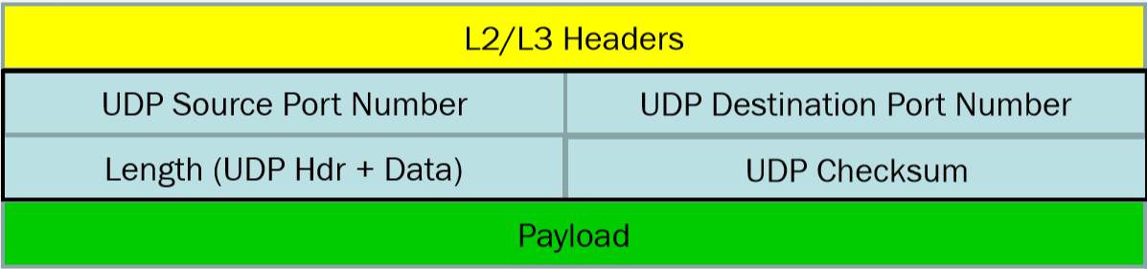
OSI Transport Layer - UDP
Predominant protocols used at Layer-4
• TCP (Transmission Control Protocol)
• UDP (User Datagram Protocol)
UDP
• Connectionless

Slide 10
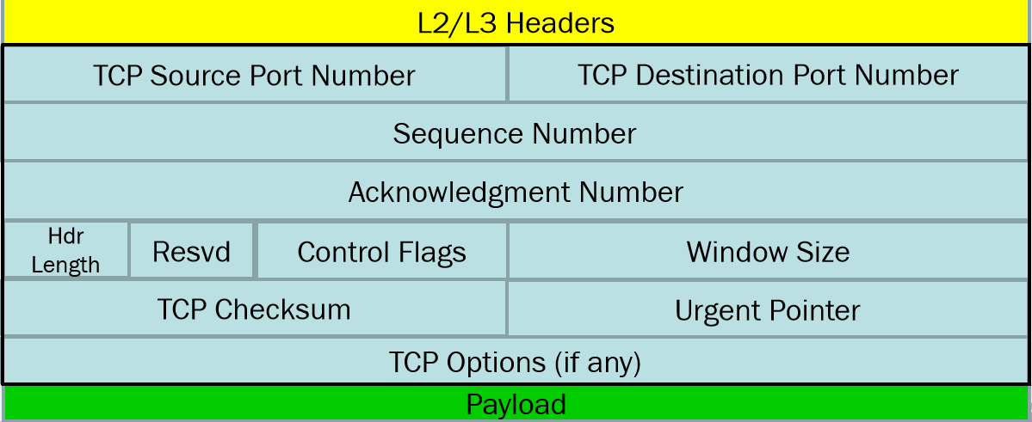
OSI Transport Layer - TCP
Transmission Control Protocol
• Connection-oriented

Slide 11
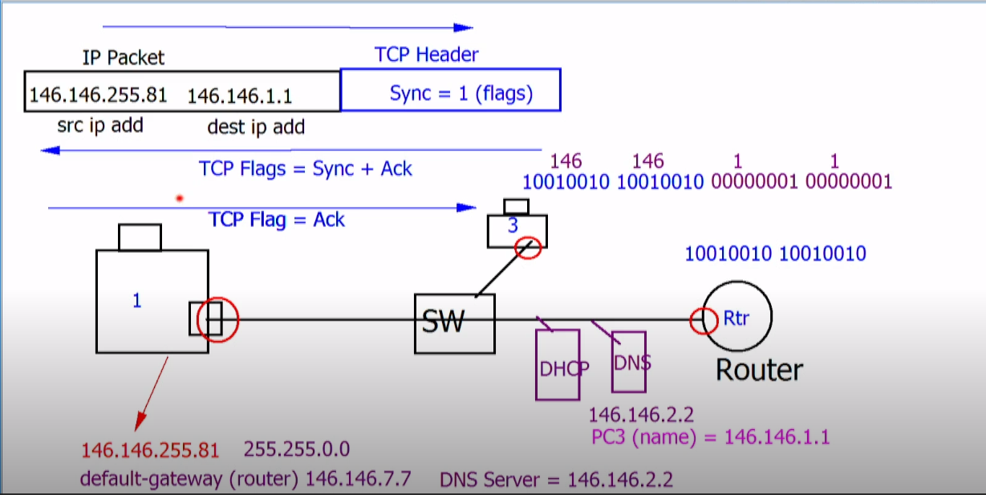
TCP 3 way handshake

